Slide 1
Pos software in harirams grocery shop
by
-Parthipan

Slide 2
Introduction
1.What is pos software
2.Main purpose pos software
3.Advantage pos software
4.Intro for harirams pos software
5.Report generation

Slide 3
What is pos software ?
POS software (Point of Sale software) is a type of software used by businesses to complete transactions with customers. It helps manage the checkout process, track sales, inventory, customer data, and other essential business functions. POS software typically works alongside hardware components like cash registers, barcode scanners, receipt printers, and payment terminals.

Slide 4
Main purpose pos software ?
Processing Transactions
Inventory Management
Generating Reports and Insights
Improving Customer Experience
Enhancing Business Efficiency

Slide 5
Advantage ?
Efficiency and Speed
Inventory Management
Improved Customer Experience
Financial Management
Scalability
Sales Data and Analytics

Slide 6
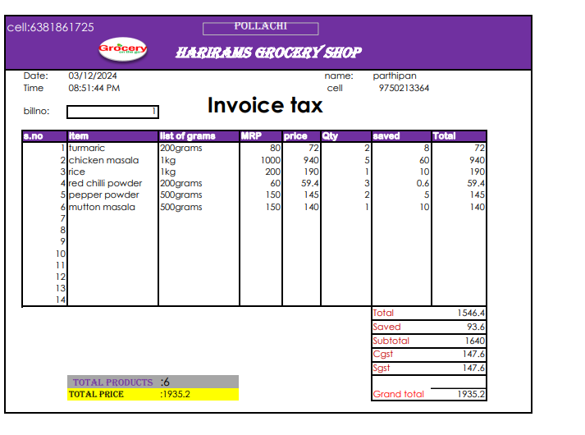
Intro for harairams pos software:
Pos design

Slide 7
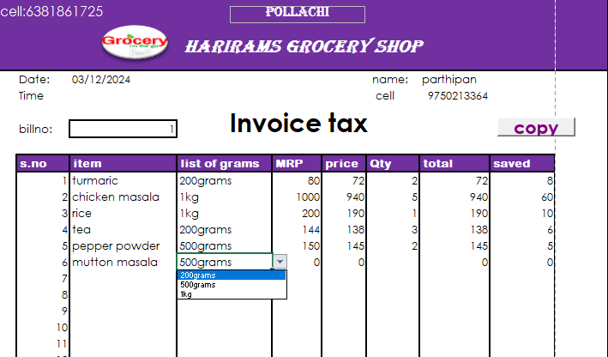
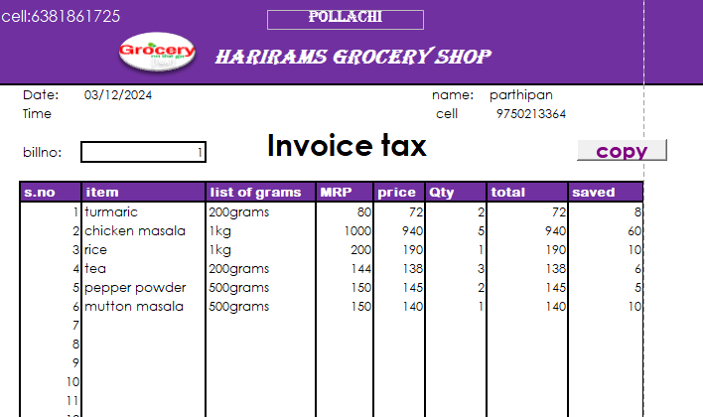
Scalability and avoid human errors:
Scalability in POS (Point of Sale) systems refers to the ability to handle increased transaction volume or expanded operations without compromising performance, while human error in POS systems involves mistakes made during transactions, such as incorrect data entry or miscommunication, which can impact accuracy and efficiency.

Slide 8

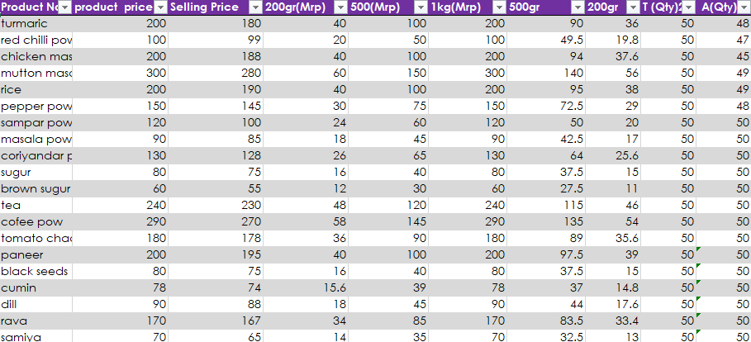
Inventory management
Inventory management in a Point of Sale (POS) system refers to the processes and tools that help businesses track, control, and manage their stock or products. The goal is to ensure the right products are available at the right time while minimizing excess inventory, reducing stockouts, and streamlining operational efficiency. Here’s an overview of how inventory management works in a POS system:

Slide 9
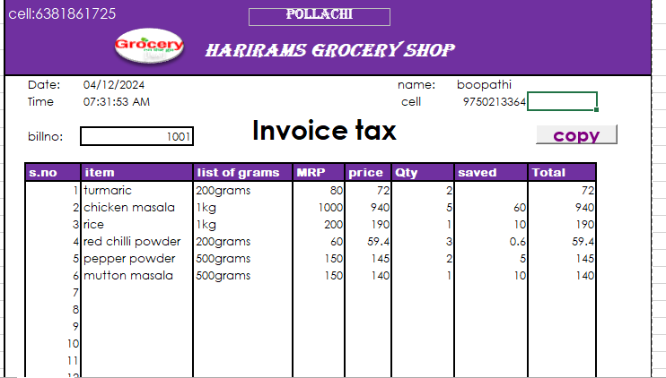
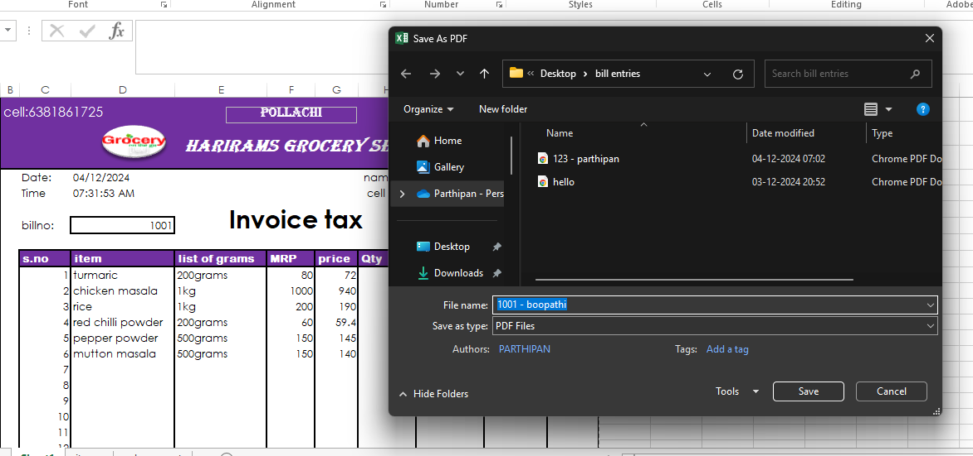
Report generation:
Date Range: Reports can be filtered by specific time periods (daily, weekly, monthly, yearly) or custom date ranges.
Filters and Sorting: Reports can be filtered and sorted by product, category, employee, location, etc.
Downloadable Formats: Reports can typically be exported to various formats such as PDF, CSV, Excel, or printed for easy sharing.

Slide 10
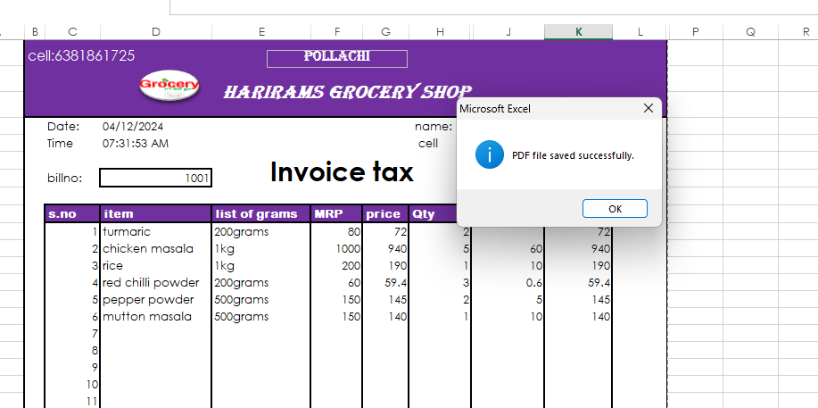
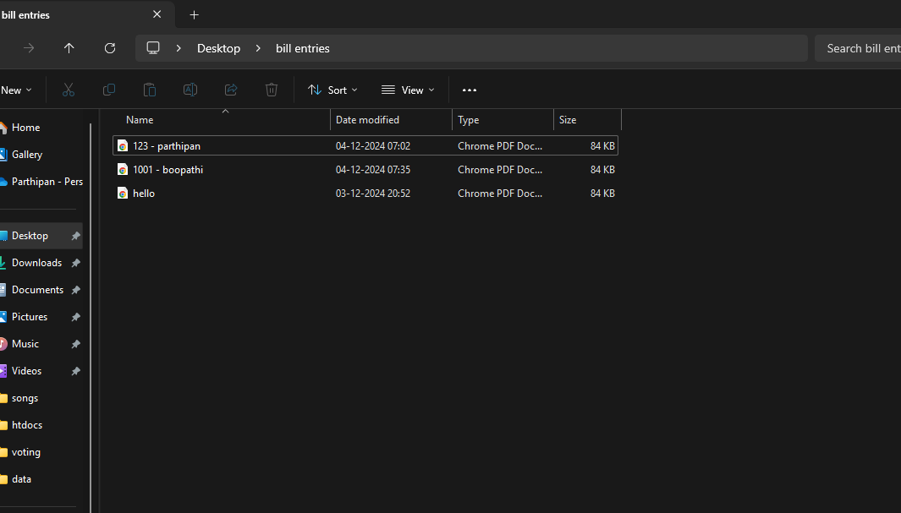
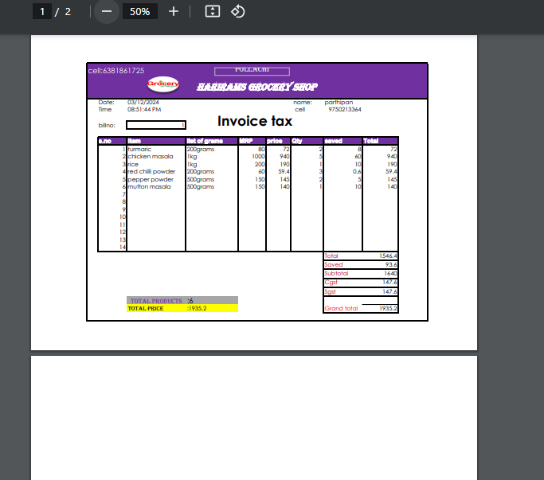
Report:

Slide 11
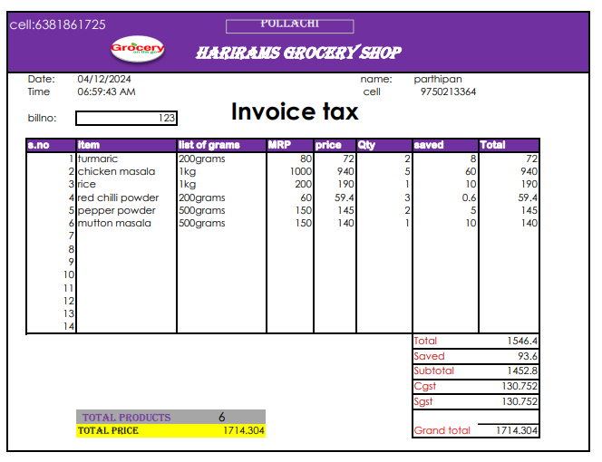
=TEXT(TODAY(),"dd/mm/yyy")
TEXT(NOW(), "hh:mm:ss AM/PM")
IFERROR(F10-G10," ")
IFERROR(IF(E10="1kg",VLOOKUP(D10,Table2,2,FALSE)*H10,IF(E10="200grams",VLOOKUP(D10,Table2,4,FALSE)*H10,IF(E10="500grams",(VLOOKUP(D10,Table2,5,FALSE))*H10," ")))," ")
=COUNTA(D10:D23)
=K24-K25
=K26*9%

Slide 12
Thank you

